Slide 1
Lecture 02: Proportion
Chris Walshaw
Computing & Mathematical Sciences
University of Greenwich

Slide 2
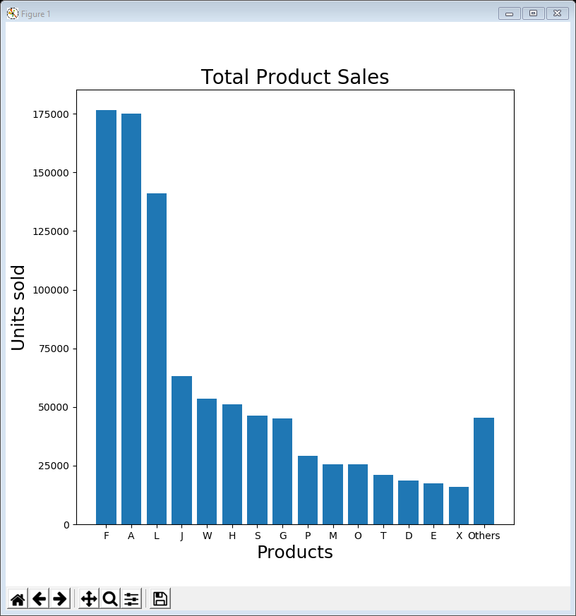
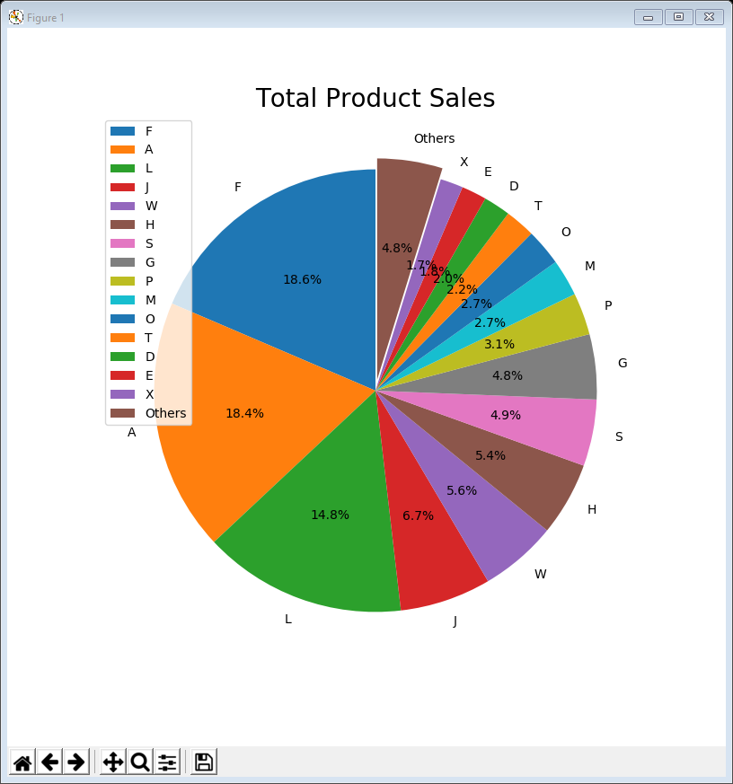
Motivation / Objectives
The company who supplied the data introduced last week would like to rationalise their product list
They want to know about products that
don’t sell well or
aren’t very profitable or
cost too much to market or …
Today we compare the volume of total sales for each product using two standard plot types
bar charts
pie charts

Slide 3
Common features
Almost all of today’s examples start with the same lines of code to import the libraries & read in the data
this week we also use numpy – Numerical Python (https://numpy.org/)
They also contain the following lines to prepare and show the plot
import matplotlib.pyplot as plt
import numpy as np
import pandas as pd
data = pd.read_csv('https://tinyurl.com/ChrisCoDV/Products/DailySales.csv',
index_col=0)
plt.figure(figsize=(8, 8))
... # this is where you draw the plot
plt.show()

Slide 4
The data
As we saw last week the daily sales data contains
25 columns, one for each product type
365 rows, one for each day of the year
We are going to initially explore the total sales for each product over the year
to get a sense of the proportions of each
We can actually print this out for any Pandas dataframe with .sum()
as well as getting a summary with .head()
print(data.head())
print(data.sum())

Slide 5
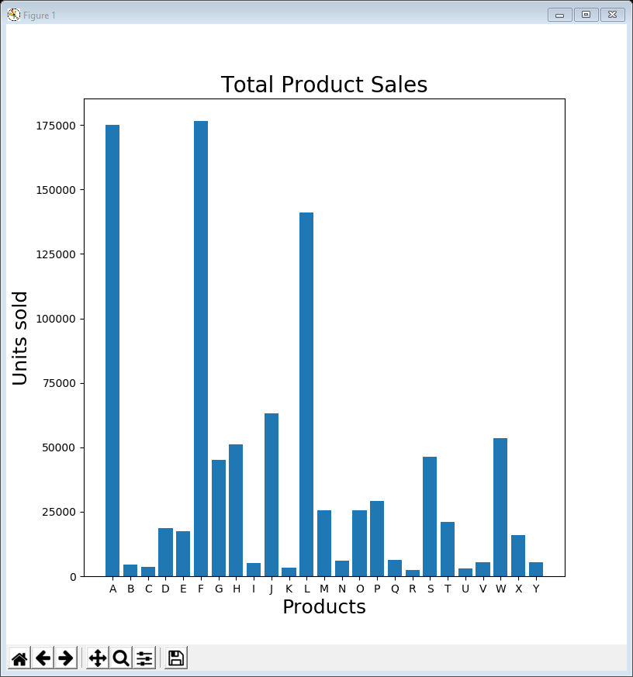
01BarChart all.py
The following code creates the plot on the right
The lines in bold actually create the bar chart
see next slide
The other lines prepare the figure, add labels and title and finally show it
plt.figure(figsize=(8, 8))
x_pos = np.arange(len(data.columns))
plt.bar(x_pos, data.sum(), align='center')
plt.xticks(x_pos, data.columns)
plt.xlabel('Products', fontsize=18)
plt.ylabel('Units sold', fontsize=18)
plt.title('Total Product Sales', fontsize=20)
plt.show()

Slide 6
Creating the bar chart
First use NumPy to create a range of positions for each column of data
Then create a bar chart, plotting the positions on the x-axis against the total sales (using .sum()) on the y-axis
Finally put tick marks on the x-axis at the same position as the bars, with the column names as the tick values
x_pos = np.arange(len(data.columns))
plt.bar(x_pos, data.sum(), align='center')
plt.xticks(x_pos, data.columns)

Slide 7
Segmenting the data
It’s easy to distinguish the 3 high volume (best selling) products
F is slightly better than A and both are better than L
Not so easy to distinguish medium volume
i.e. those around 50,000 units sold
Quite hard to distinguish low volume
is M better than O?
Really hard to distinguish very low volume
To overcome this we segment the data by selecting certain groups of products

Slide 8
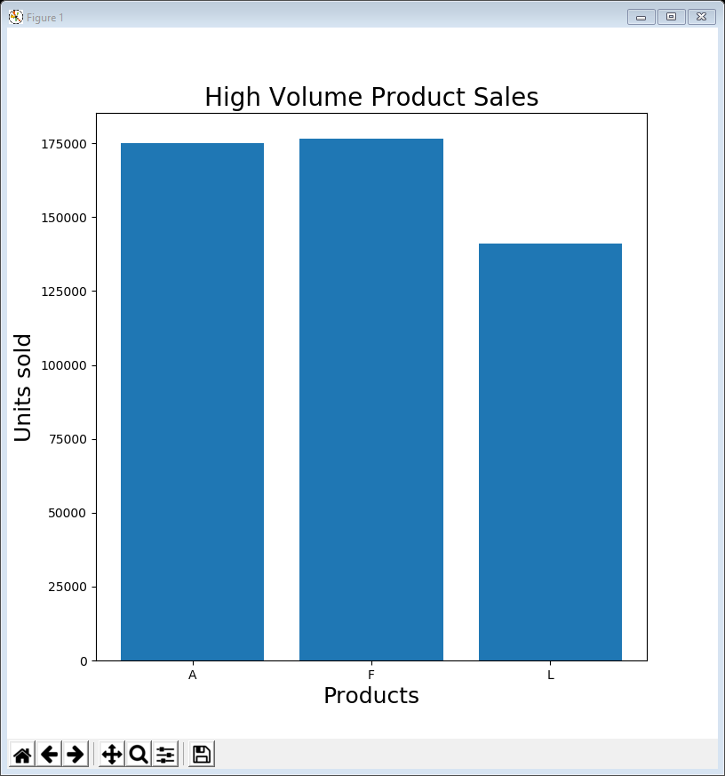
02BarChart high volume.py
Just select some of the columns and replace data with data[selected]
The code in bold shows changes from example 01
don’t forget to change the chart title!
selected = ['A', 'F', 'L']
print(data[selected].head())
plt.figure(figsize=(8, 8))
x_pos = np.arange(len(data[selected].columns))
plt.bar(x_pos, data[selected].sum(), align='center')
plt.xticks(x_pos, data[selected].columns)
plt.xlabel('Products', fontsize=18)
plt.ylabel('Units sold', fontsize=18)
plt.title('High Volume Product Sales', fontsize=20)
plt.show()

Slide 9
Examples 03, 04, 05
Just repeat for other selections …
… medium volume
… low volume
… very low volume
selected = ['G', 'H', 'J', 'S', 'W']
selected = ['D', 'E', 'M', 'O', 'P', 'T', 'X']
selected = ['B', 'C', 'I', 'K', 'N', 'Q', 'R',
'U', 'V', 'Y']

Slide 10
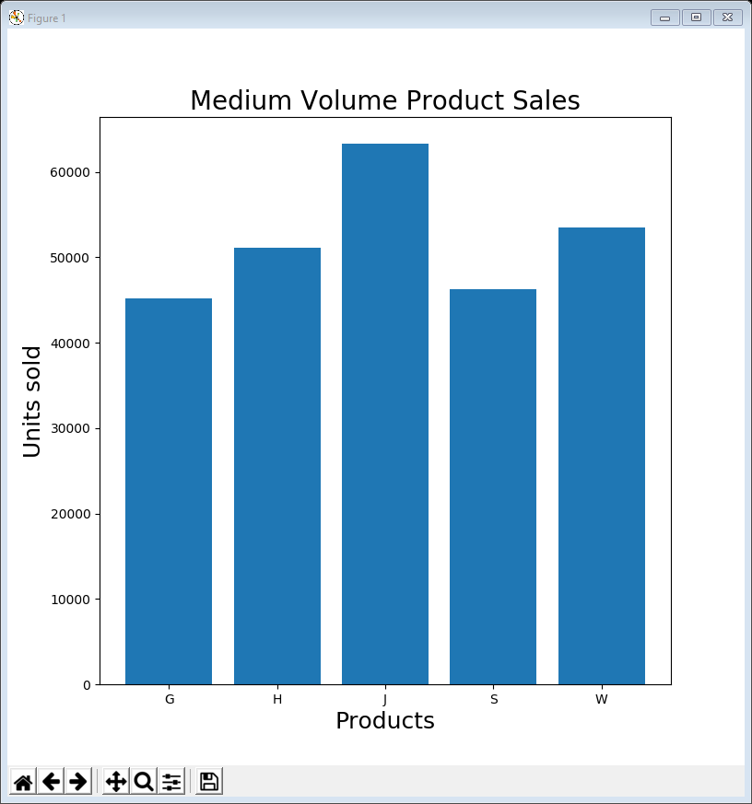
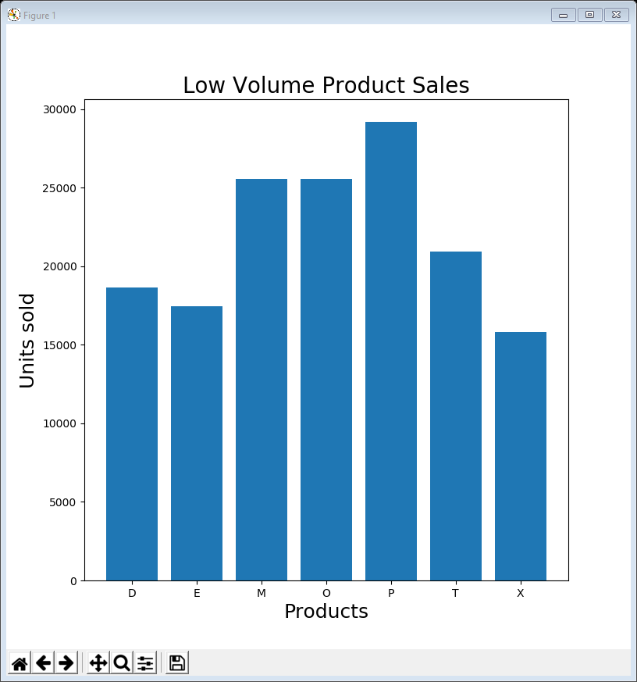
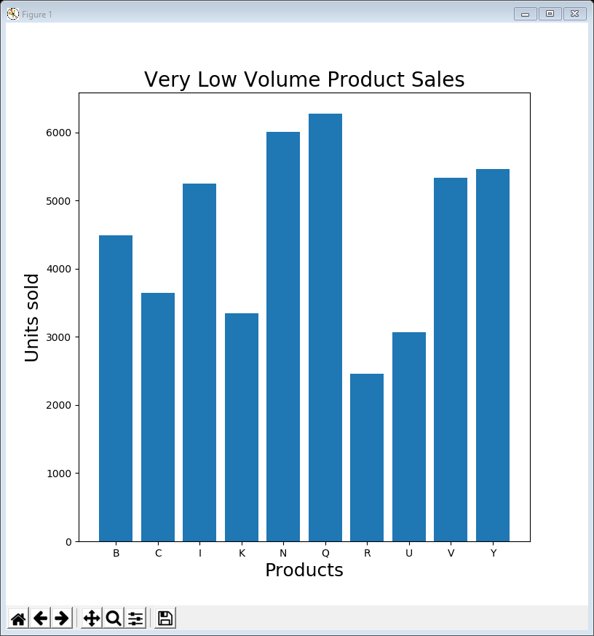
Examples 03, 04, 05
The plots produced
notice the scales on the y-axis are very different

Slide 11
Automatic categorisation
The manual selection of different categories of data is a bit laborious
imagine if we had 250 products, rather than 25
or even 250,000!
Instead we can
decide on the limits of each category
get the code to work the selections out

Slide 12
06BarChart automatic.py – data wrangling
The following code selects which category each product is in
loops over each product
decides on the category based on total sales
adds it to the selected category
categories = ['High', 'Medium', 'Low', 'Very Low']
categories_selected = [[] for i in range(len(categories))]
for name in data.columns:
total_sales = data[name].sum()
if total_sales > 100000:
category = 0
elif total_sales > 40000:
category = 1
elif total_sales > 10000:
category = 2
else:
category = 3
categories_selected[category].append(name)
print('Product ' + name + ' is ' + categories[category] + ' volume')

Slide 13
06BarChart automatic.py – plotting
To output the plots, just loop over the different categories
the actual plotting code is almost unchanged
for i, selected in enumerate(categories_selected):
plt.figure(figsize=(8, 8))
x_pos = np.arange(len(data[selected].columns))
plt.bar(x_pos, data[selected].sum(), align='center')
plt.xticks(x_pos, data[selected].columns)
plt.xlabel('Products', fontsize=18)
plt.ylabel('Units sold', fontsize=18)
plt.title(categories[i] + ' Volume Product Sales', fontsize=20)
plt.show()

Slide 14
Improving the overall picture
The previous example helps to understand relative sales proportions in each category
but what about understanding the dataset as a whole?
Returning to the original example we can improve it in a number of different ways by
using colours to help understanding the categories
sorting the data, largest to smallest (or vice-versa)
grouping some of the products together

Slide 15
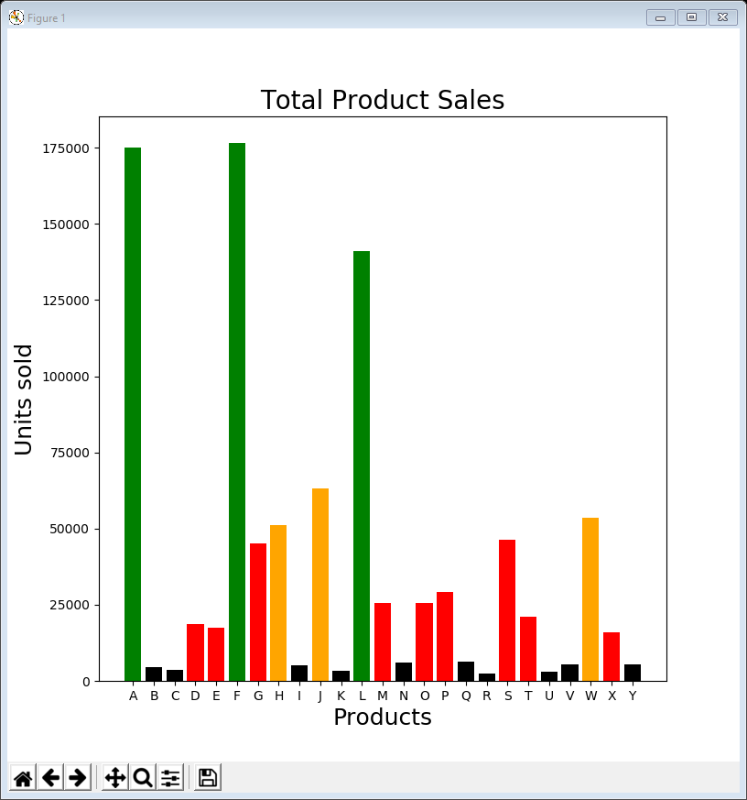
07BarChart all coloured.py
To colour each category, create a list of colours, one for each product, by adapting the categorisation code
The plotting code is exactly the same as example 01 with one tiny change (to use the colours)
colours = []
for name in data.columns:
total_sales = data[name].sum()
if total_sales > 100000:
colour = 'green'
elif total_sales > 50000:
colour = 'orange'
elif total_sales > 10000:
colour = 'red'
else:
colour = 'black'
colours.append(colour)
plt.bar(x_pos, data.sum(), align='center', color=colours)

Slide 16
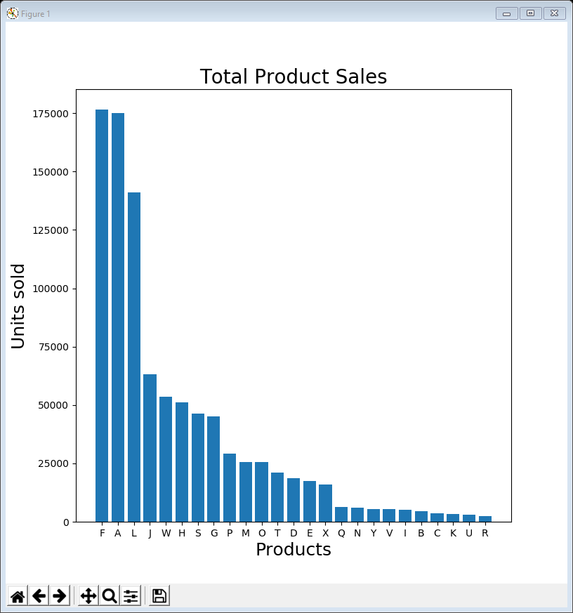
08BarChart all sorted.py
Sorting the products by total size is even easier
the plotting code is exactly the same as example 01
Just need to insert the following line of code to sort it
the parameter axis=1 sorts columns (rather than rows)
data = data.reindex(data.sum().sort_values(ascending=False).index, axis=1)

Slide 17
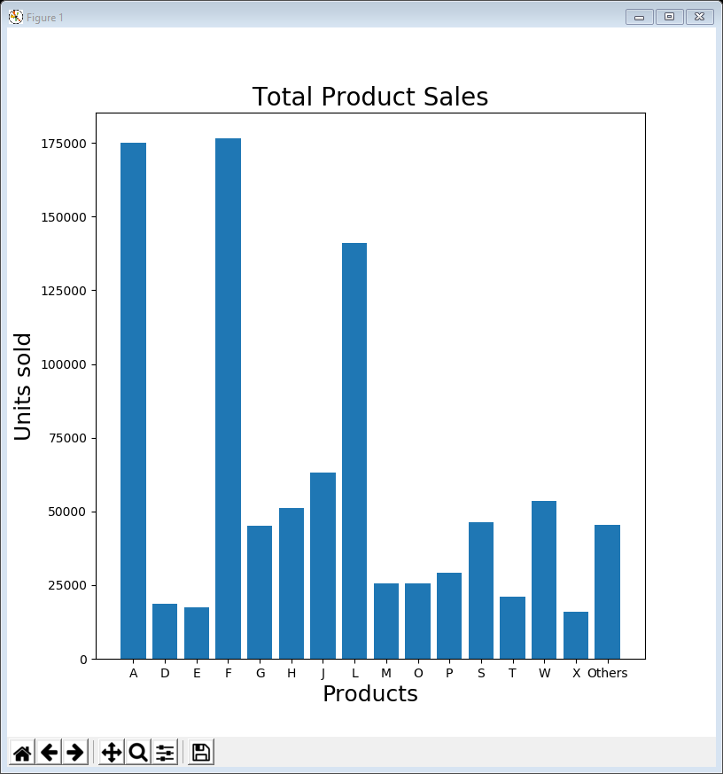
09BarChart grouped.py
The following code loops over all the columns grouping very low volume products together
create a new column called ‘Others’ and fill it with zeroes
if the total sales are big enough, append the product to the selected list
if not, add the sales from this column into the ‘Others’ column
finally add the ‘Others’ column to the selected list
selected = []
columns = data.columns
data['Others'] = [0] * len(data.index)
for name in columns:
total_sales = data[name].sum()
if total_sales > 10000:
selected.append(name)
else:
data['Others'] += data[name]
selected.append('Others')
print(data[selected].head())

Slide 18

10BarChart grouped sorted.py
The picture becomes even clearer if you sort all the columns before grouping
From a data exploration / visualisation point of view this shows what proportion of the overall total is very low volume
the total very low volume sales are not insignificant

Slide 19
Bar chart guidelines
Many good practices are already done by default in matplotlib (although you can override them)
include spaces between bars (approximately ½ bar width)
use horizontal labels if at all possible
start the y-axis at 0
Also valuable to order data appropriately
alphabetically, sequentially or by value

Slide 20
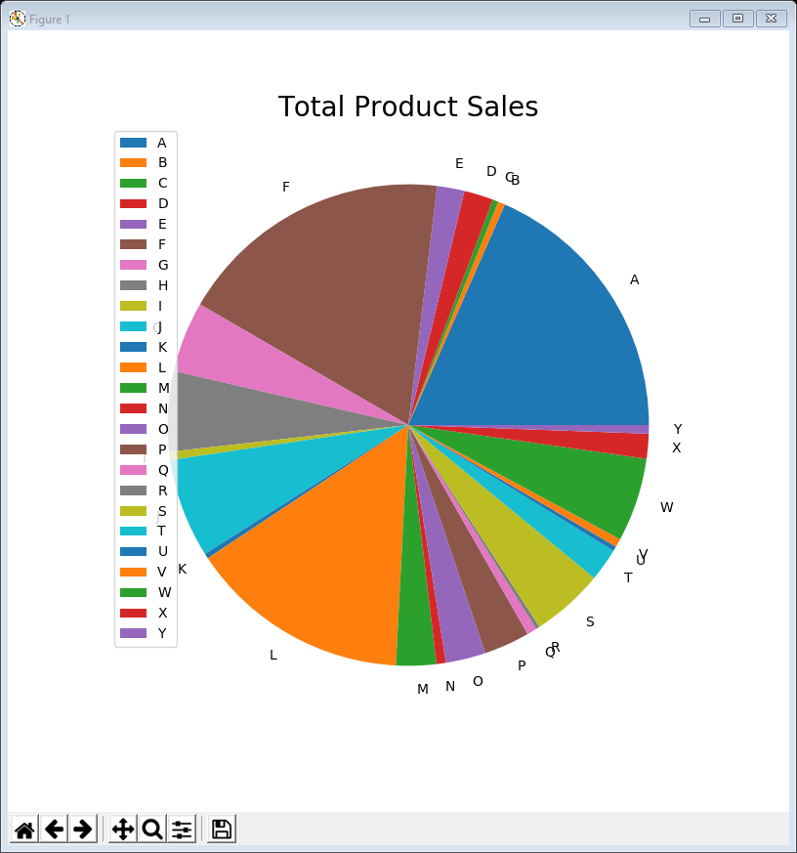
11PieChart all.py
Drawing a pie chart of the total sales is easy
Apart from reading in the data just need the following code
the legend is a list of all the pie segments
plt.figure(figsize=(8, 8))
plt.pie(data.sum(), labels=data.columns)
plt.title('Total Product Sales', fontsize=20)
plt.legend(loc=2)
plt.show()

Slide 21
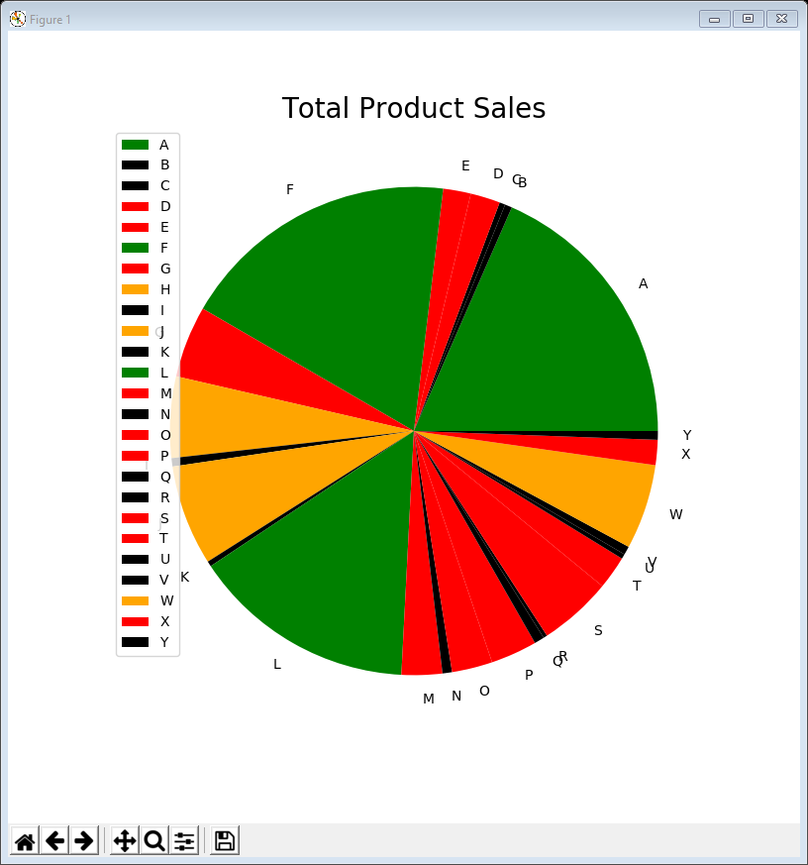
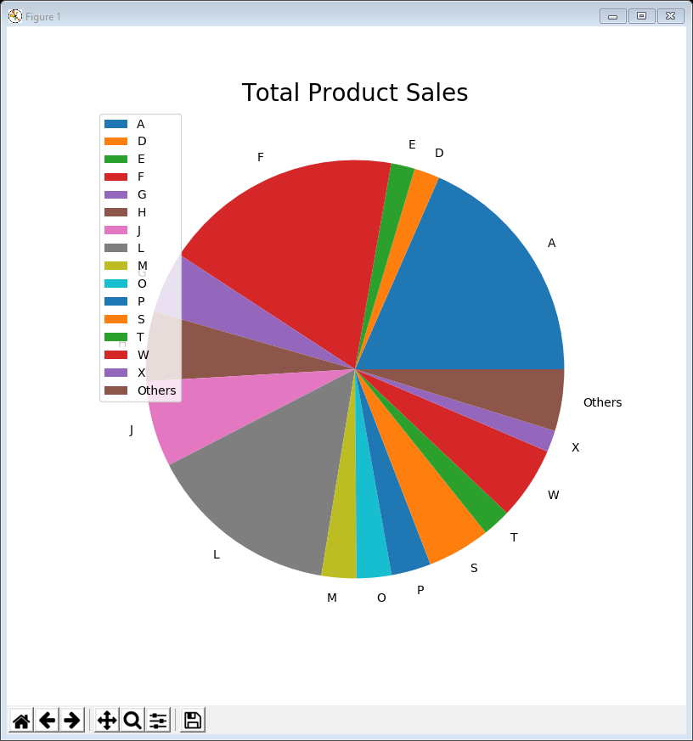
Improving pie charts – examples 12 & 13
As before we can colour the segments according to whether they high / medium / low / very low volume
using exactly the same code as example 07
but while this may be pretty it’s not very illuminating
Alternatively we can group the very low volume products
using exactly the same code as example 09
still not particularly illuminating

Slide 22
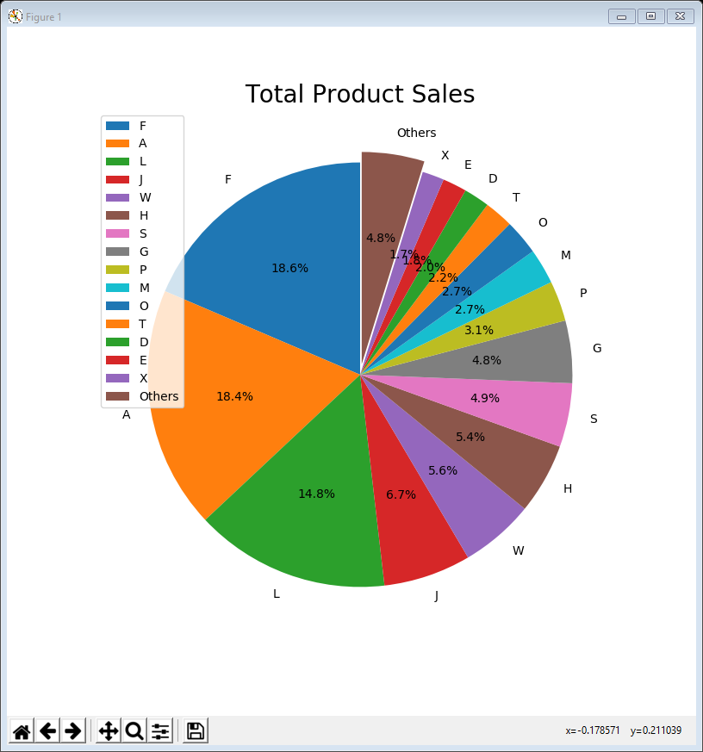
14PieChart grouped sorted.py
The final example improves the picture by grouping & sorting (like example 10
Also there are a number of refinements
labelling pie slices with their percentage size using the autopct parameter
setting the startangle to 90⁰ so the biggest slice starts at the top
exploding one of the slices to highlight it
plt.figure(figsize=(8, 8))
plt.pie(data[selected].sum(), labels=selected,
autopct='%1.1f%%', startangle=90,
explode=explodeList)
plt.title('Total Product Sales', fontsize=20)
plt.legend(loc=2)
plt.show()

Slide 23
Pie chart guidelines
Pie charts are not popular in the world of data visualisation
humans have difficulty evaluating relative sizes of segments (much easier to compare relative heights of bar chart columns)
If you are going to use one:
include percentages
start with the biggest segment at the top and sort in order of size
don’t use more than ~10-20 segments

Slide 24
Data conclusions
We are not making business decisions
the data scientist’s role is to explore the data
let the business analyst decide what to do
However …
easy to identify very low volume products visually – big size difference between X and Q
but the total volume of very low volume products is not insignificant (nearly 5% of all sales) … so the company can’t just get rid of all of them
Need to explore further!

Slide 25
Lecture summary
Looked at visualising relative proportions using
bar charts
pie charts
Can significantly enhance data exploration by
segmenting / categorising (high / medium / low)
grouping
sorting
labelling

